Slide 1
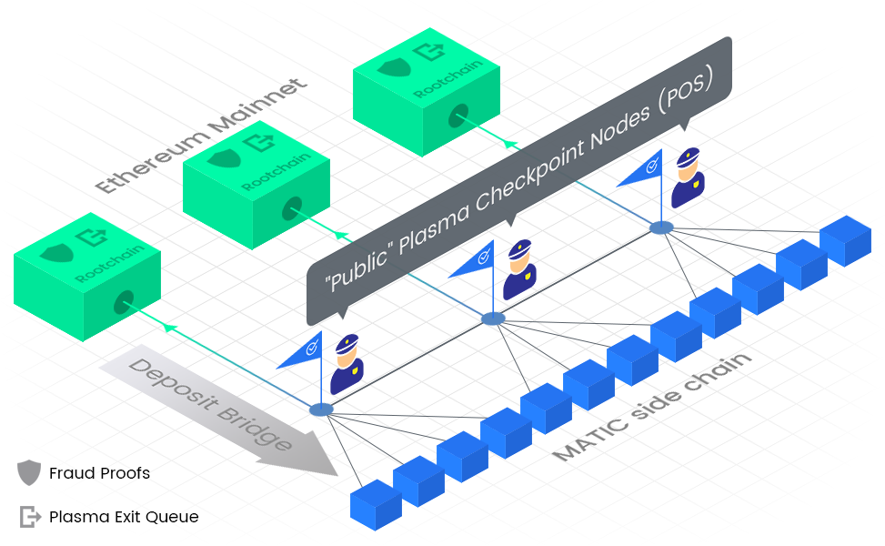
Polygon - Architecture
Within Polygon's architecture, its proof-of-stake sidechain utilizes different layers to harness the capabilities of Ethereum effectively:
Bor: This layer is responsible for producing blocks within the Polygon network. It is compatible with the Ethereum Virtual Machine (EVM) and serves as the foundation for processing and grouping transactions into blocks.

Slide 2
Polygon - Architecture
Within Polygon's architecture, its proof-of-stake sidechain utilizes different layers to harness the capabilities of Ethereum effectively:
Heimdall: As a crucial layer, Heimdall performs validator and checkpointing functions within Polygon. It consolidates blocks generated by Bor, grouping them into checkpoints. Heimdall then creates a lightweight hash of these checkpoints and publishes them to the Ethereum mainnet.

Slide 3
Polygon - Architecture
Within Polygon's architecture, its proof-of-stake sidechain utilizes different layers to harness the capabilities of Ethereum effectively:
Smart Contracts: Smart Contracts on Ethereum Mainnet: Polygon's architecture includes a set of smart contracts deployed on the Ethereum mainnet. These contracts serve important purposes such as facilitating staking of Polygon's native MATIC token and establishing checkpoints.

Slide 4
Polygon - Architecture
In summary, Polygon's architecture empowers users to stake MATIC tokens on the Ethereum mainnet. These stakers actively participate in the validation process of the Polygon Network. The Bor layer efficiently groups transactions into blocks, while the Heimdall layer further consolidates these blocks into checkpoints. Finally, Heimdall publishes a condensed representation of these checkpoints to the Ethereum mainnet, ensuring the network's integrity and reliability.

Slide 5
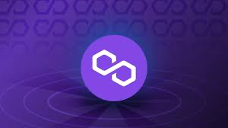
Polygon - Architecture
Polygon achieves its speed and cost-effectiveness through a clever mechanism called selective validation and checkpointing. Let's explore how this works in a more educational and engaging manner:
Imagine a bustling validator community, all working together to process blocks and validate transactions within Polygon. However, if each validator had to validate every single block, the process would be sluggish and resource-intensive, leading to delays and higher costs. That's where Polygon's selective validation approach comes into play.
Polygon carefully selects a smaller subset of validators from its vibrant community. These chosen validators collaborate and produce blocks for a specific time period, ensuring efficient and swift processing. Once their time is up, a new subset of validators takes over, keeping the network running smoothly in a continuous rotation.

Slide 6
Polygon - Architecture
To fortify the security of the network, checkpoints play a crucial role. The Heimdall layer, a vital component within Polygon, takes charge of validating a group of blocks produced by the selected validators in the Bor layer. It then creates a unique hash, like a condensed summary, representing this group of blocks. This hash is then securely sent to a smart contract deployed on the Ethereum mainnet.
Here's where Ethereum serves as a valuable backup hard drive for Polygon's state. By leveraging Ethereum's established security and robustness, Polygon ensures the integrity of its operations. If, at any point, a validator within the network acts maliciously, their staked MATIC tokens on the Ethereum mainnet are slashed, resulting in a significant financial loss for them. This strong economic deterrent maintains the trust and reliability of the Polygon network.
In this ingenious way, Polygon combines the advantages of Ethereum's security and stability without burdening every single transaction with the full weight of Ethereum's validation process. By staking and checkpointing on Ethereum, Polygon achieves a balance between efficiency and security, allowing for faster, more cost-effective transactions while ensuring the overall integrity of the network.

Slide 7
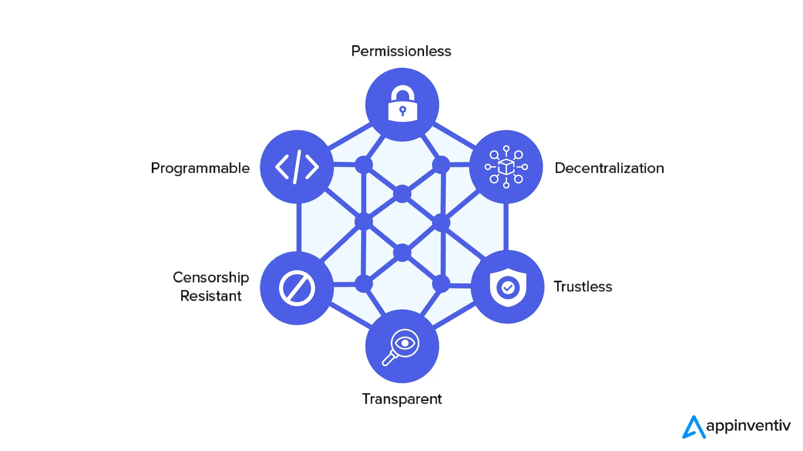
Decentralized Finance DeFi
Decentralized Finance, or DeFi, is a revolutionary concept that brings traditional financial services to the decentralized realm of blockchain. It aims to provide open, accessible, and inclusive financial solutions to individuals worldwide, without the need for intermediaries like banks or financial institutions.
In DeFi, financial transactions and services are executed through smart contracts on blockchain platforms like Ethereum. These smart contracts automate and enforce the terms of agreements, ensuring transparency and eliminating the need for intermediaries.

Slide 8
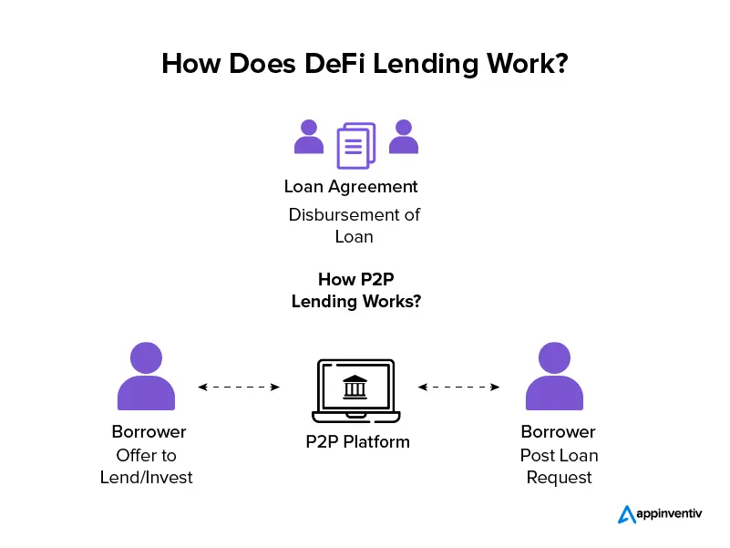
Decentralized Finance DeFi
Lending and Borrowing: DeFi platforms enable individuals to lend or borrow digital assets directly from others. Through smart contracts, borrowers can access funds without going through traditional credit checks, while lenders earn interest on their deposited assets. This opens up new opportunities for accessing capital and earning passive income.

Slide 9
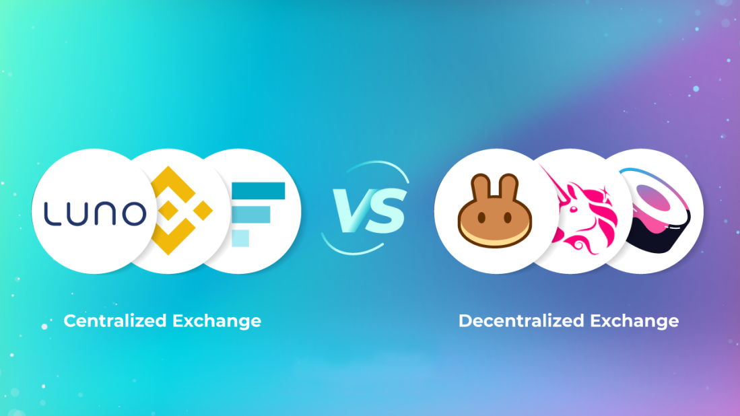
Decentralized Finance DeFi
Decentralized Exchanges (DEXs): Traditional exchanges are centralized entities that facilitate asset trading. In contrast, decentralized exchanges operate on blockchain and allow users to trade assets directly with one another using smart contracts. This provides greater control over funds, reduces the risk of hacking or manipulation, and fosters a more open and transparent trading environment.

Slide 10
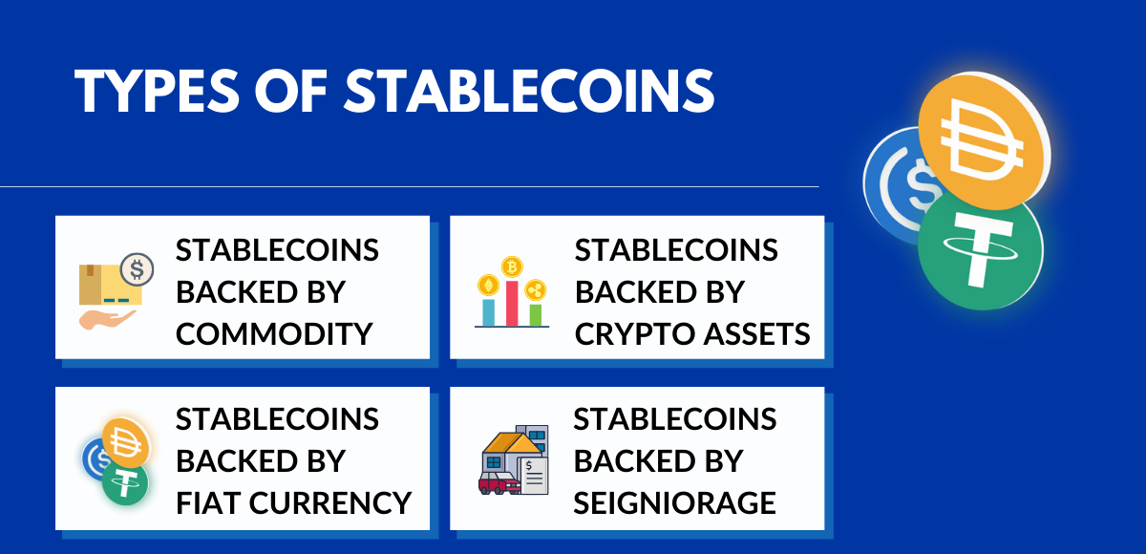
Decentralized Finance DeFi
Stablecoins and Synthetic Assets: DeFi platforms offer stablecoins, which are cryptocurrencies designed to maintain a stable value by pegging them to real-world assets like the US Dollar. Synthetic assets, on the other hand, replicate the value of other assets, such as stocks or commodities, enabling users to gain exposure to different markets without direct ownership.

Slide 11
Decentralized Finance DeFi
DeFi's practical applications are expanding rapidly, and its potential to disrupt traditional finance is significant. However, it's important to conduct thorough research, understand the risks involved, and exercise caution when participating in DeFi protocols, as the space is still evolving and can be complex.

Slide 12
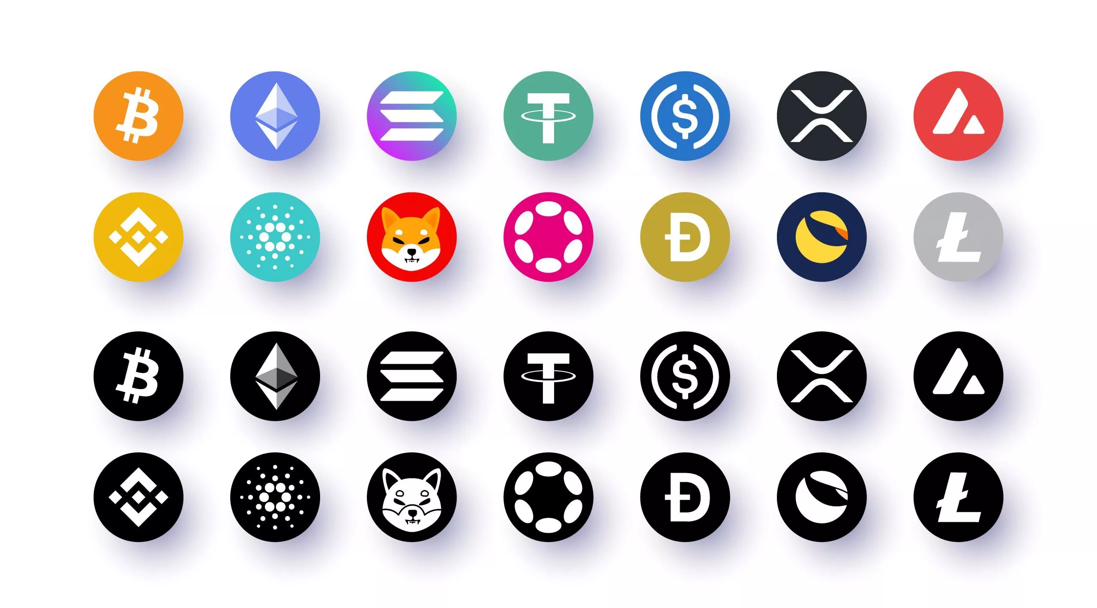
What Are Tokens
Within the realm of blockchains, tokens refer to cryptocurrencies that exist on a particular blockchain network. Some well-known examples of cryptocurrencies include Bitcoin and Ether. However, it's important to note that tokens can also represent other assets or functionalities within a blockchain ecosystem.
Ether (ETH) holds a unique position as the transactional token that fuels the Ethereum Network. It serves a crucial role in facilitating transactions and executing smart contracts on the Ethereum platform. As the native currency of Ethereum, Ether is used to pay for computational services and as a measure of value within the network.

Slide 13
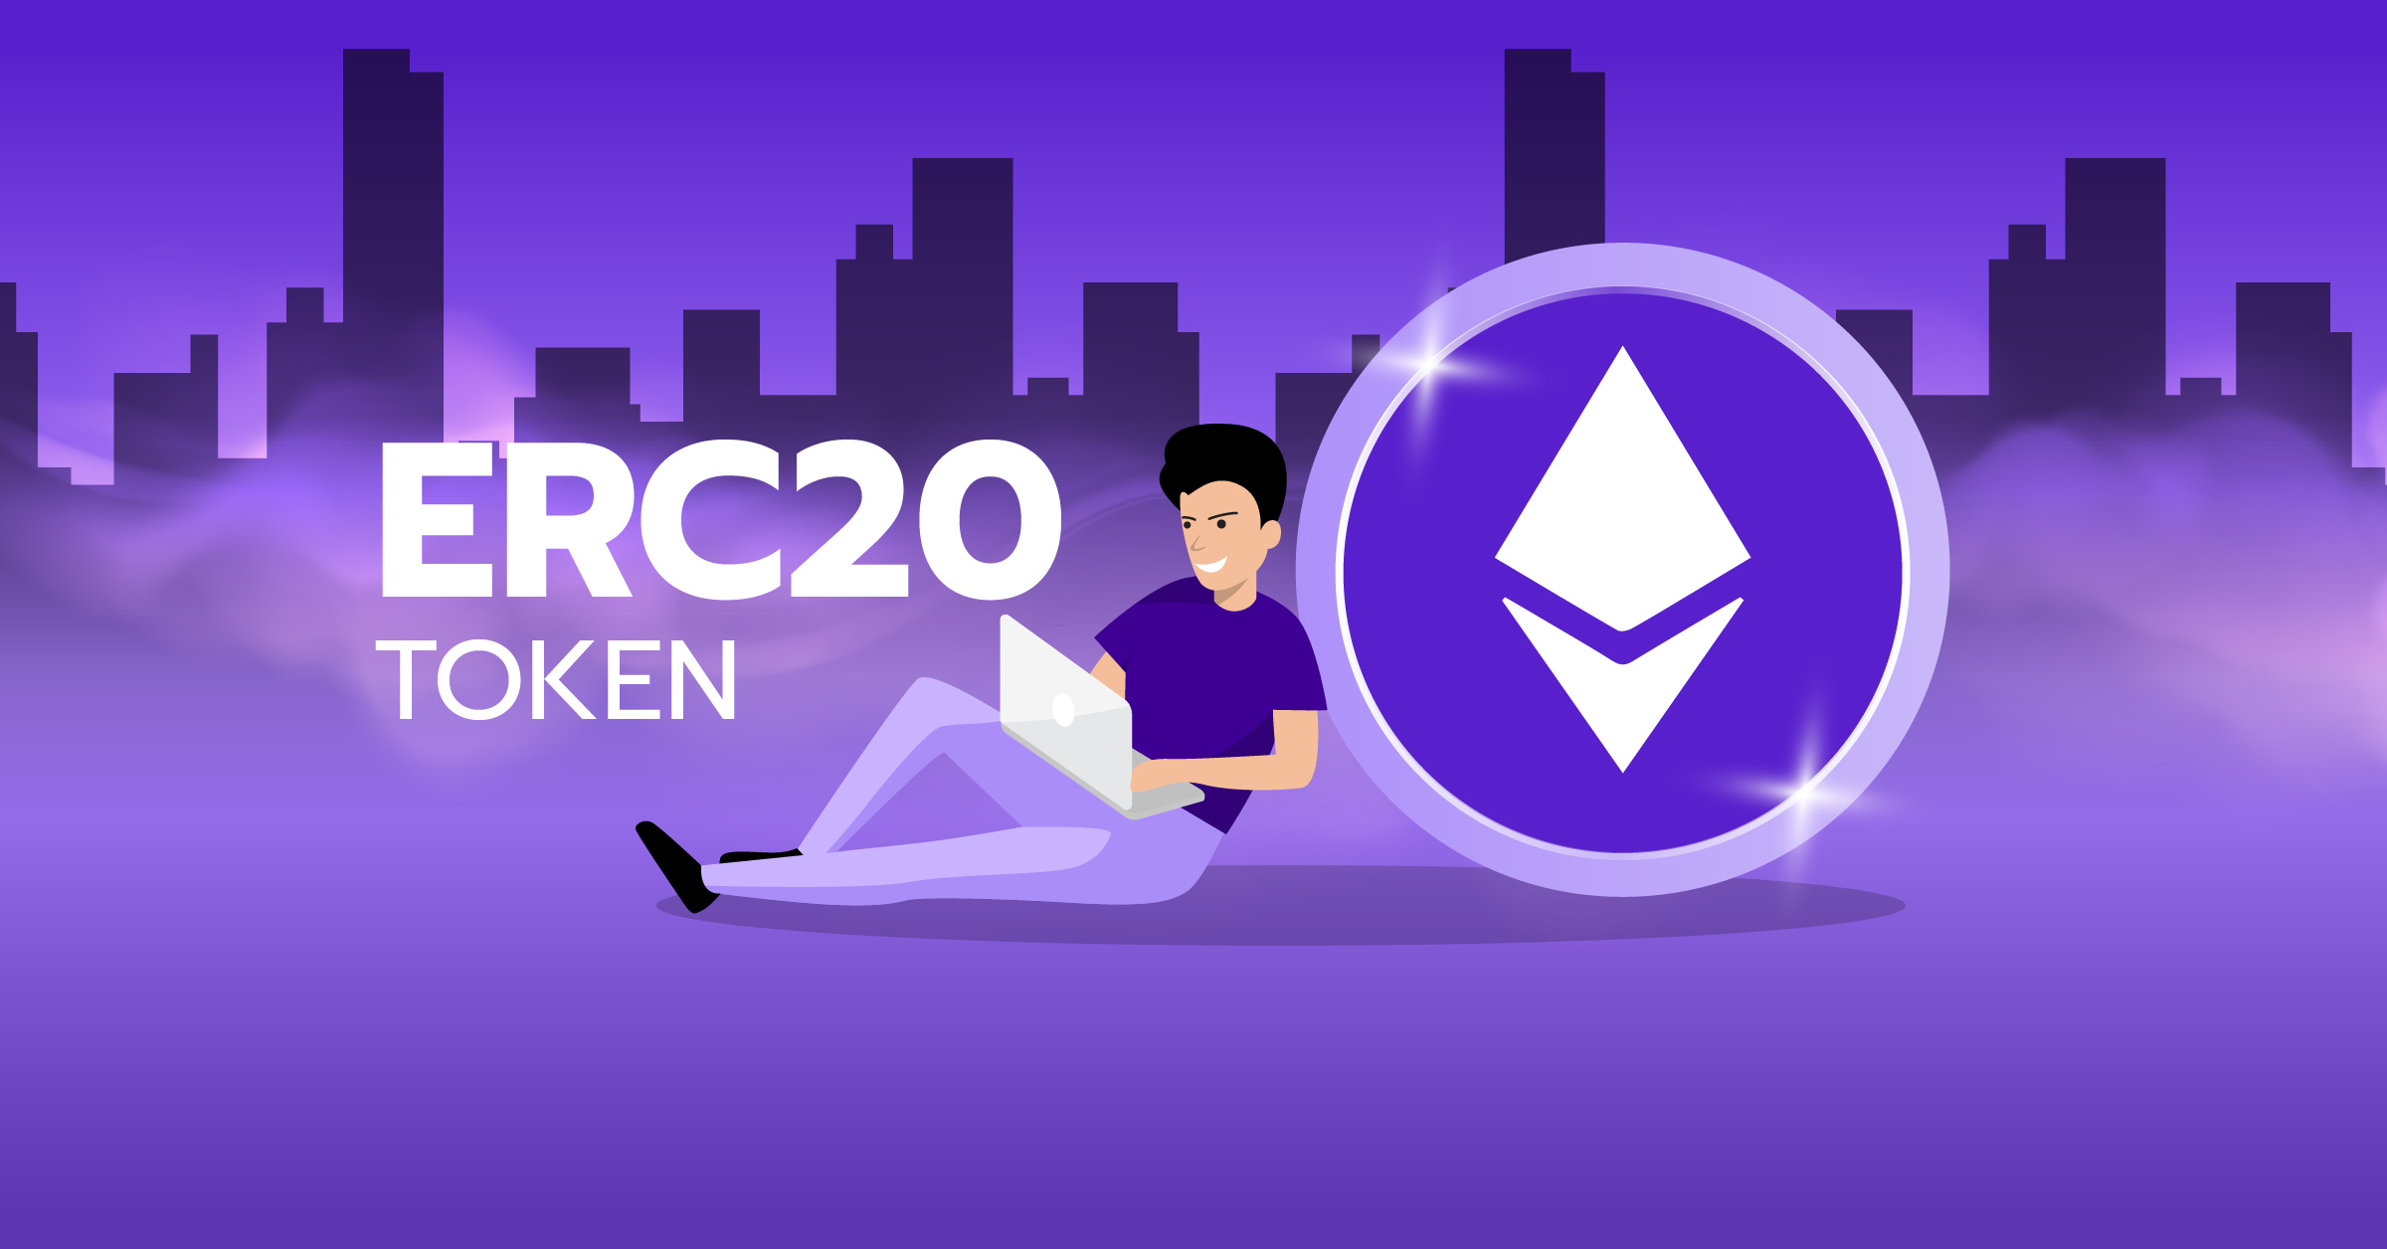
ERC20 STANDARD
ERC20 is a widely adopted standard for creating tokenized smart contracts on the Ethereum network. It establishes a common framework that ensures compatibility and interoperability among tokens within the Ethereum ecosystem, as well as EVM-compatible networks like Polygon.
In the world of decentralized finance (DeFi) on Ethereum, the ERC20 standard plays a pivotal role. The term "ERC" stands for "Ethereum Request for Comment," which signifies a set of standards that developers and users adhere to for consistency and collaboration.

Slide 14
ERC20 STANDARD
Specifically, ERC20 is the standard for fungible tokens. Fungibility refers to the interchangeability of tokens, where one token can be replaced with another identical token without any difference in value or functionality. For example, you can exchange one $1 bill for another $1 bill, and they hold the same value. This fungibility allows for seamless token exchanges and widespread usability.

Slide 15

ERC20 STANDARD
On the other hand, ERC-721 is the standard for non-fungible tokens (NFTs), which represent unique and indivisible assets. NFTs cannot be exchanged on a one-to-one basis since they possess distinct characteristics, making them valuable for representing collectibles, digital art, or unique assets.
In the context of DeFi and the Ethereum ecosystem, understanding the distinction between ERC20 and ERC-721 is important. ERC20 tokens facilitate fungible asset management, while ERC-721 tokens enable the ownership and trading of one-of-a-kind digital assets, offering exciting opportunities for creativity, ownership, and value creation.

